Slide 1

Electric Water Heater Project
AMIT

Slide 2
Prepared by:
Aya Raafat Mahmoud Elmudawy
Aya Sayed Ibrahim

Slide 3
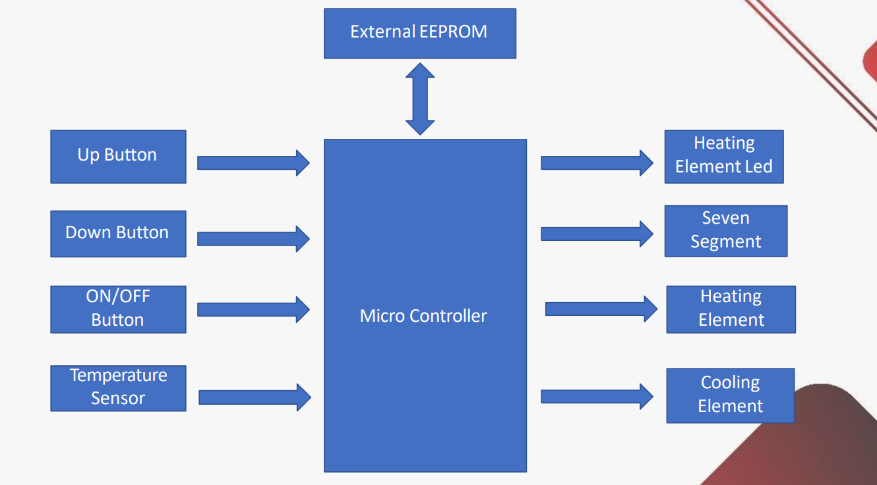

Slide 4
INTRODUCTION

Slide 5
This Project aims to control the temperature of a water using a heater and cooler using on and off control. This will be done electrically using microcontroller and some other components like
24C08 EEPROM, or use the internal.
Temp sensor (LM35, or equivalent DS18B20).
Cooling Element (Peltier).
Heating Element (3d ceramic heater).
7-segments.
LEDs.
Push Buttons.
Solid State Relays.
Cooling fins & fans.

Slide 6
Specifications

Slide 7
Temperature Setting
1. The “Up” or “Down” buttons are used to change the required water temperature
(set temperature).
2. The first “Up” or “Down” button press, entersthe temperature setting mode.
3. After entering temperature setting mode, a single “Up” button press increase the set
temperature by 5 degrees.
4. After entering temperature setting mode, a single “Down” button press decrease the set
temperature by 5 degrees.
5. The minimum possible set temperature is 35 degrees.
6. The maximum possible set temperature is 75 degrees.
7. The “External E2PROM” should save the set temperature once set.
8. If the electric water heater is turned OFF then ON, the stored set temperature should be
retrieved from the “External E2PROM”.
9. The initial set temperature is 60 degrees

Slide 8
ON/OFF Behavior
1. If power is connected to the heater, the electric water heater is in OFF state.
2. If the “ON/OFF” button is released and the electric water heater is in OFF state, the electric
water heater goes to ON state.
3. If the “ON/OFF” button is released and the electric water heater is in ON state, the electric
water heater goes to OFF state.
4. In the OFF state, all display should be turned OFF
Temperature Sensing
The temperature sensor measures the water temperature.
2. The water temperature should increase, if the “Heating Element” is ON.
3. The water temperature should decrease, if the “Cooling Element” is ON.
4. Temperature should be sensed once every 100 ms.
5. The decision to turn ON or OFF either the “Heating Element” or the “Cooling Element” based
on the average of the last 10 temperature readings

Slide 9
Heating/Cooling Elements
1. The “Heating Element” should be turned ON, if the current water temperature is less than
the set temperature by 5 degrees.
2. The “Cooling Element” should be turned OFF, if the current water temperature is less than
the set temperature by 5 degrees.
3. The “Heating Element” should be turned OFF, if the current water temperature is greater
than the set temperature by 5 degrees.
4. The “Cooling Element” should be turned ON, if the current water temperature is greater
than the set temperature by 5 degrees
Heating Element Led
1. If the “Heating Element” is ON, the “Heating Element Led” should blink every 1 second.
2. If the “Cooling Element” is OB, the “Heating Element Led” should be ON

Slide 10
Seven Segments
1. Seven segment by default show the current water temperature or the set temperature.
2. By default, the 2 seven segment displays are show the current water temperature.
3. If the electric water heater is in the temperature setting mode, the 2 seven segment displays
should blink every 1 second and show the set temperature.
4. In the temperature setting mode, every change in the set temperature should be reflected on the
2 seven segment displays.
5. The 2 seven segment displays should exit the temperature setting mode, if the “UP” and
“Down” buttons are not pressed for 5 seconds

Slide 11
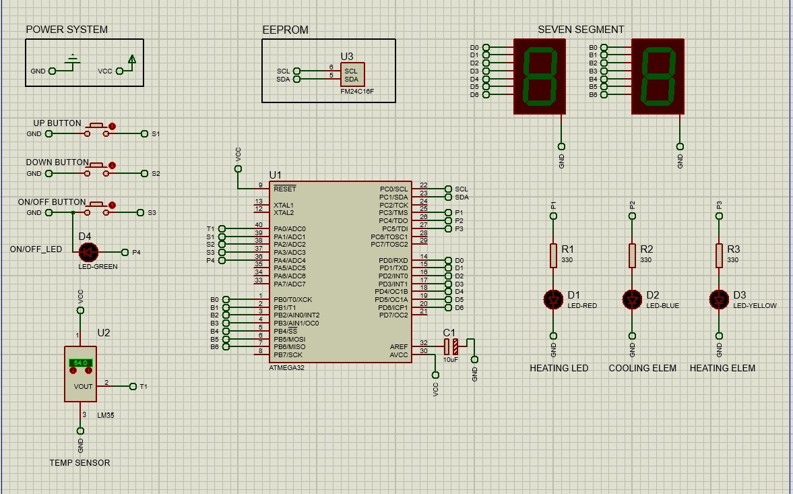

Slide 12
Emails:
ayaraafat525@gmail.com
ayasayed200168@gmail.com
Thank you

